Slide 1

Finance Canvas
Saloni Mittal
Radhika Raghuwanshi
Chaitanya Movva

Slide 2
Project vision
Finance Canvas is an innovative finance tracker designed to empower users with robust financial management tools. The application seamlessly integrates key features to streamline budgeting, enhance financial visibility, and facilitate informed decision-making.

Slide 3
Technologies/Frameworks used:
Python
Flask
SQLite3
HTML/CSS
Bootstrap
Notes:
Python: Python serves as the backend language, handling server-side logic, business logic, and interactions with the database through Flask and SQLite
Flask: Flask is a lightweight and flexible web framework for Python. It's designed to make getting started with web development quick and easy, with built-in development server and support for extensions.
SQlite: SQLite is a lightweight, embedded relational database management system (RDBMS) that operates as a self-contained, serverless, zero-configuration SQL database engine.
HTML: HTML (HyperText Markup Language) is the standard markup language used to create the structure of web pages. It defines the elements and content of a webpage.
CSS: CSS (Cascading Style Sheets) is used to style the appearance of HTML elements on a webpage. It controls layout, colors, fonts, and other visual aspects of the user interface
Bootstrap: It provides pre-designed components (like buttons, forms, navigation bars, etc.) and a responsive grid system that helps in creating consistent and visually appealing web layouts.

Slide 4
Features:
User Registration and Authentication
Adding, editing and deleting finances
Responsive design
Setting Budget to manage expenses

Slide 5
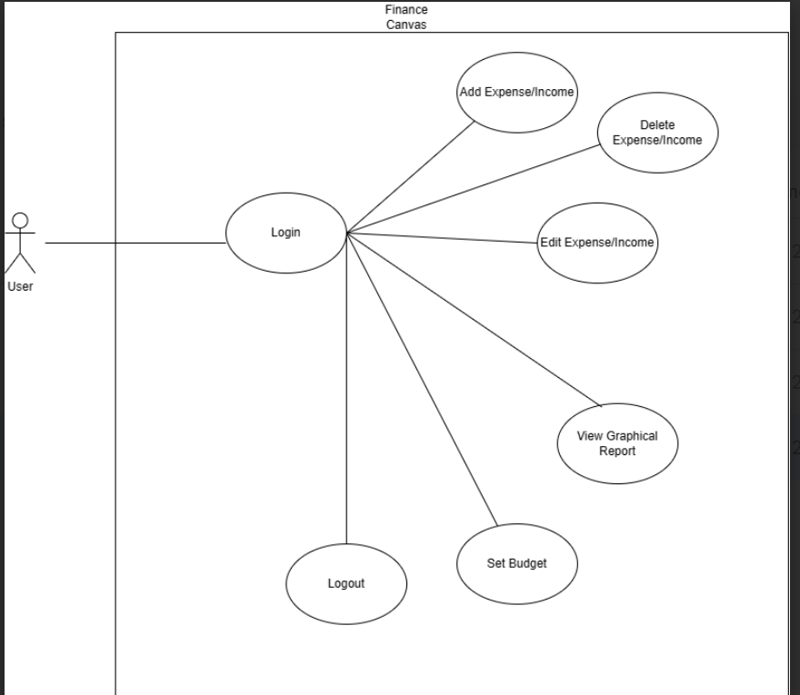
Requirements - Use Case Diagram
This use case diagram is a graphical depiction of a user’s possible interaction with Finance Canvas.

Slide 6
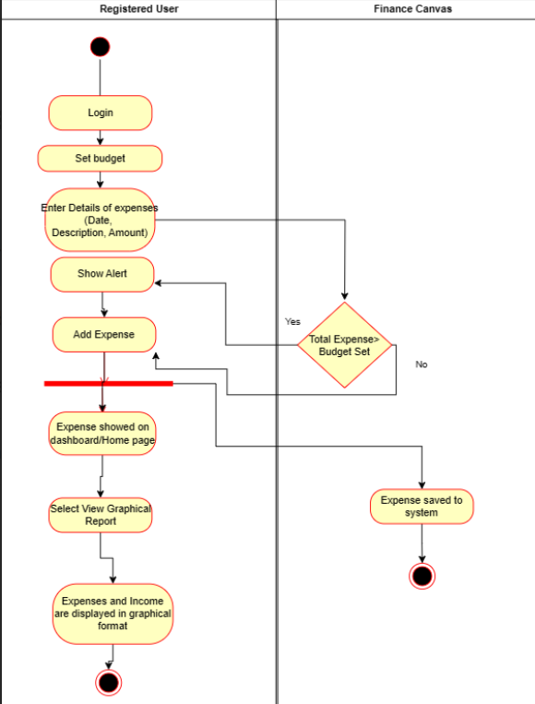
Requirements - Activity Diagram
This diagram is a graphical representation of Entering Expenses and viewing graphical report activity.

Slide 7
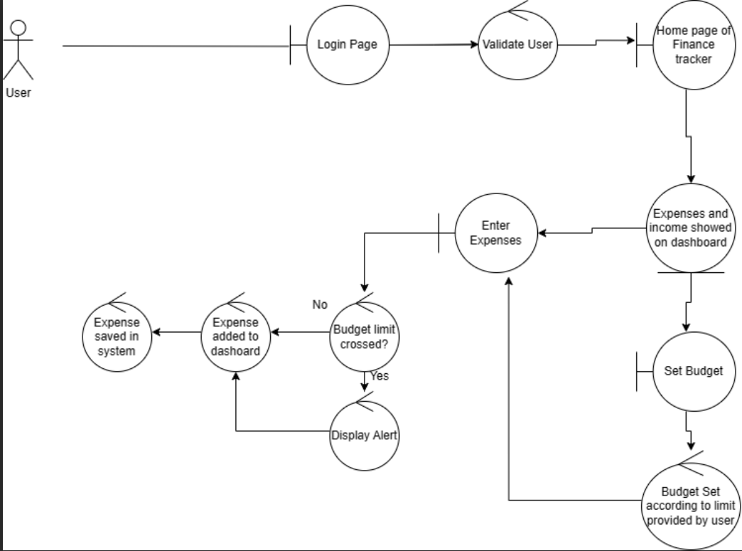
Analysis model (Robustness diagram)
This Robustness diagram focuses on the high level functionality of the finance tracker and help to visualize how the Finance Canvas will respond when user Sets Budget and enter expenses.

Slide 8
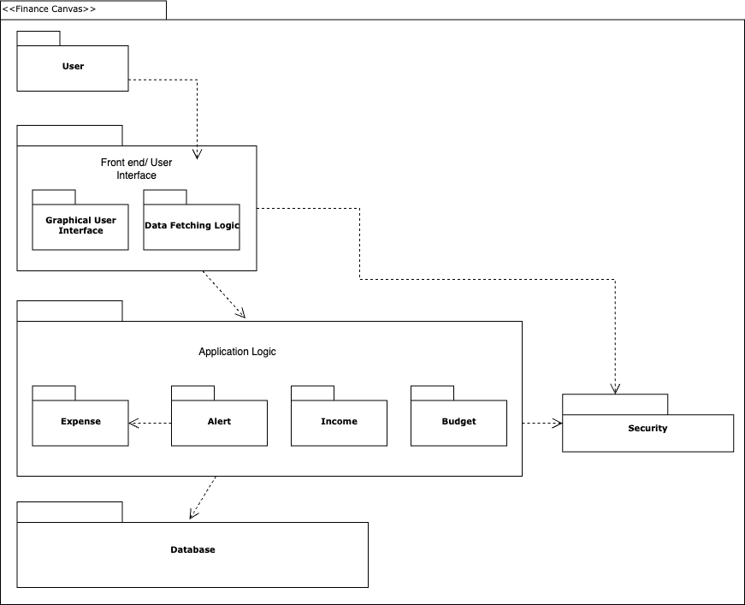
Architecture model - Package Diagram
It is a structural diagram used to show the organization and arrangement of various model elements in the form of packages.

Slide 9
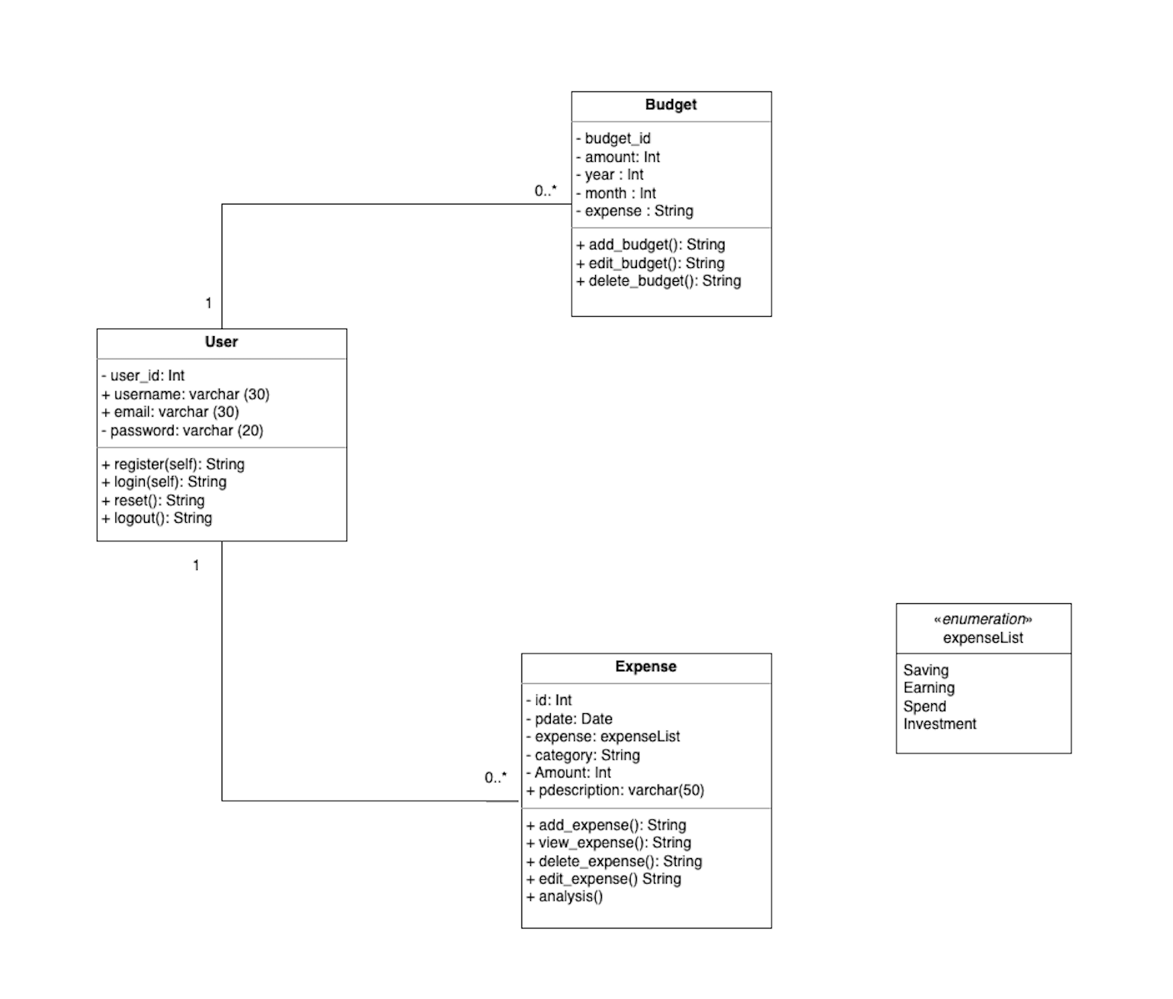
Design model - Class diagram

Slide 10
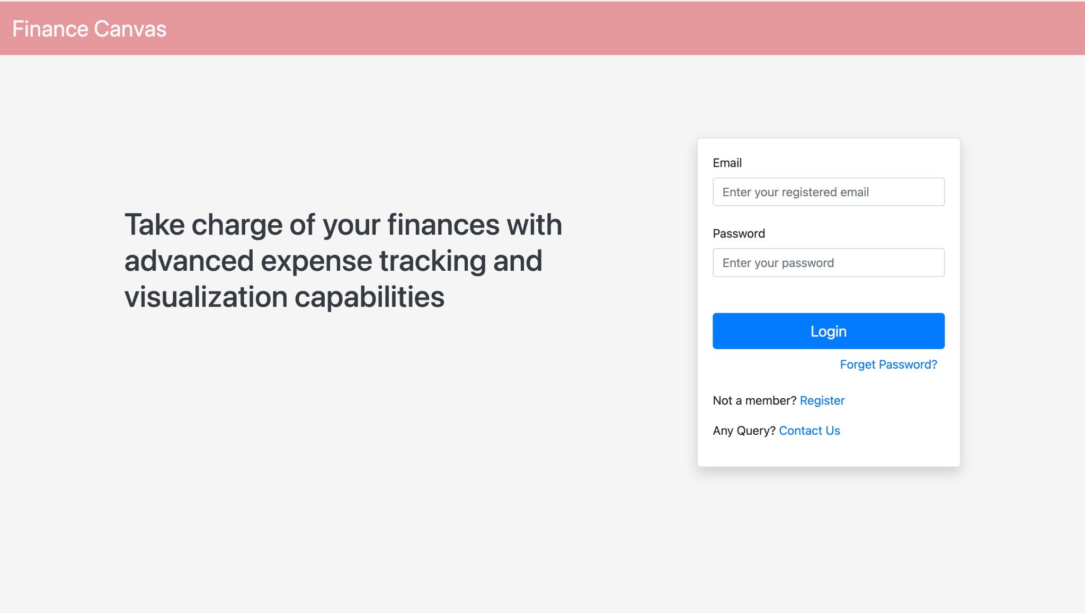
Project Demo - Login page

Slide 11
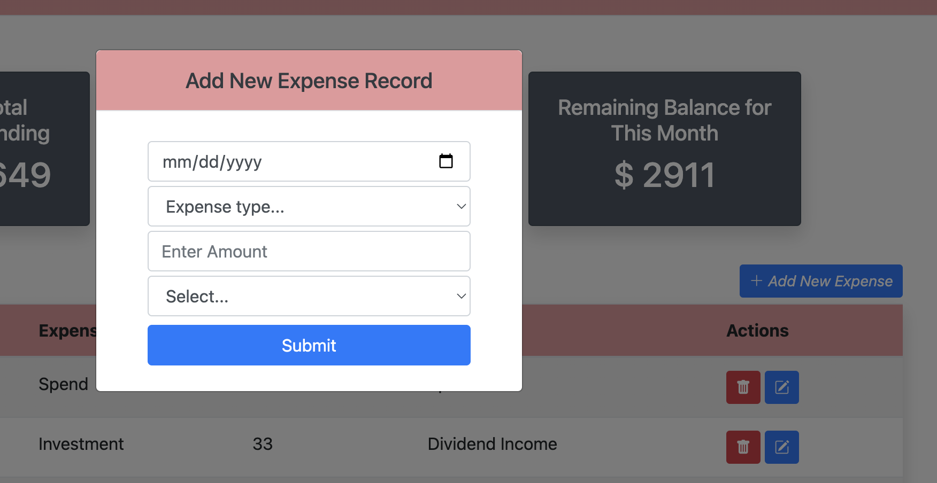
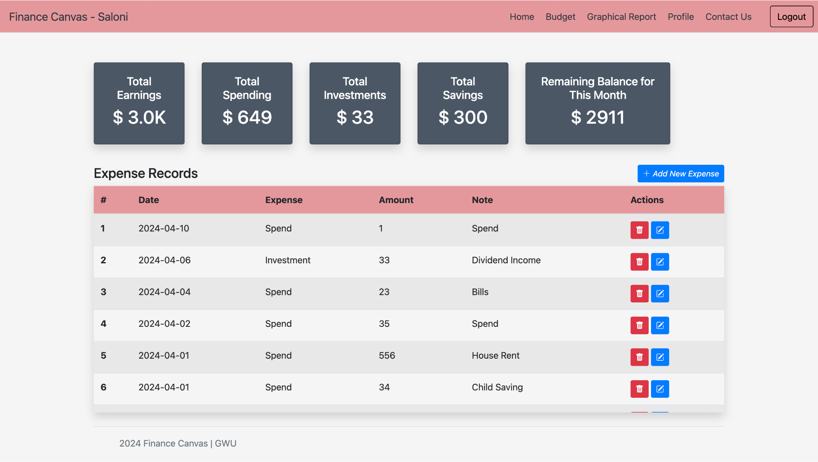
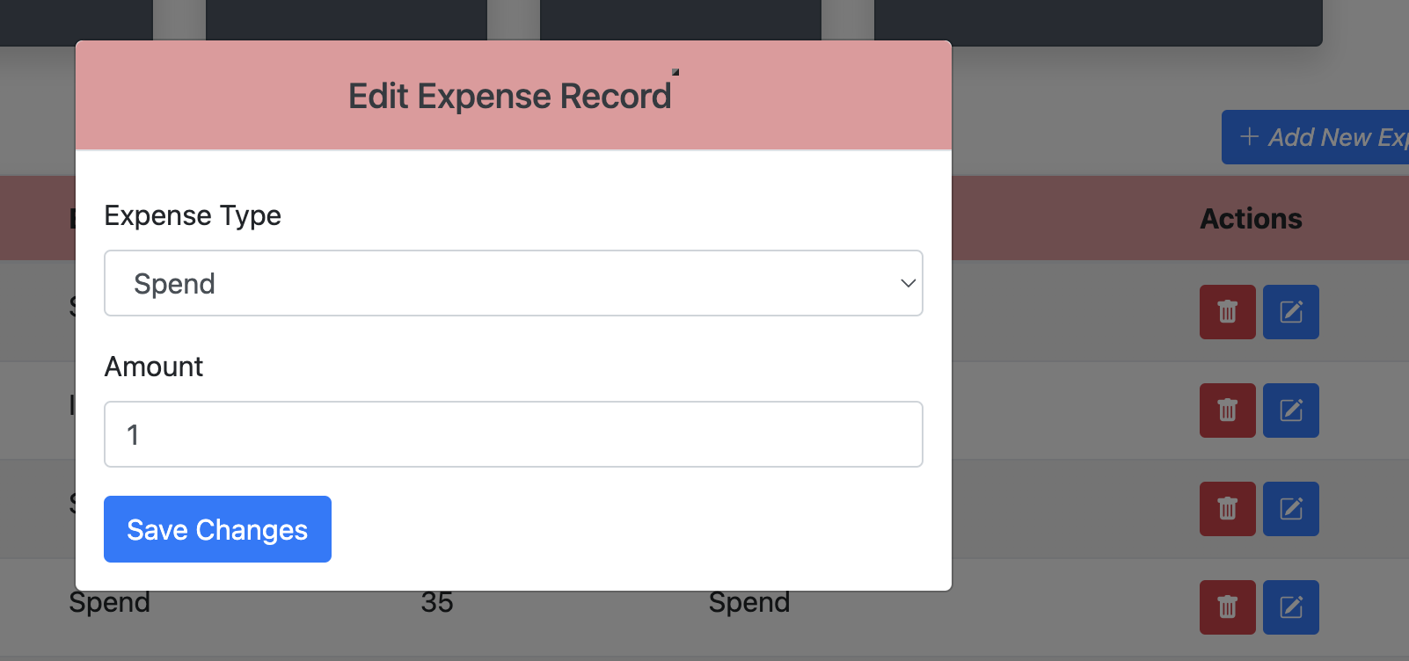
Project Demo - Home page

Slide 12
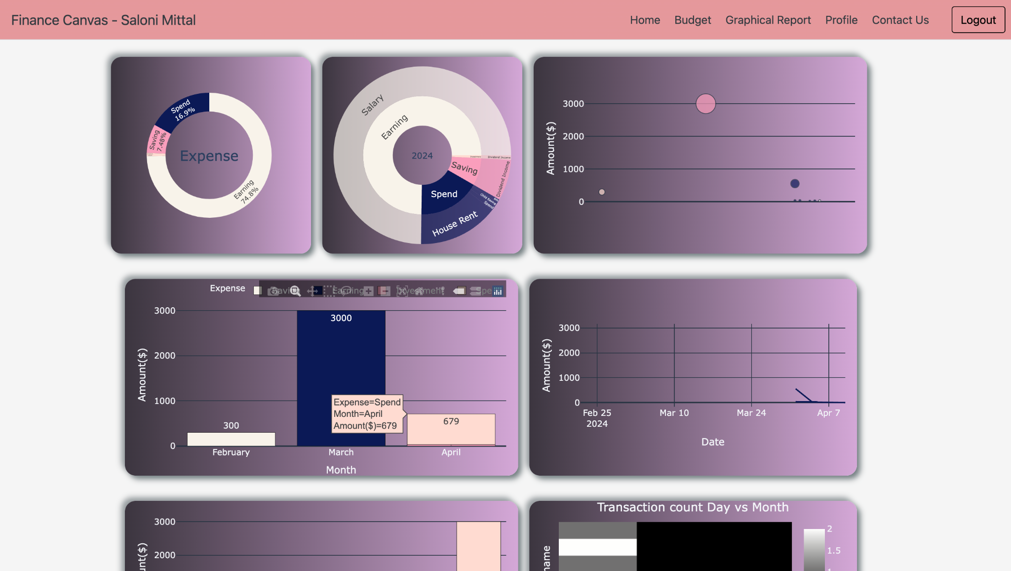
Project Demo - Graphical report page

Slide 13
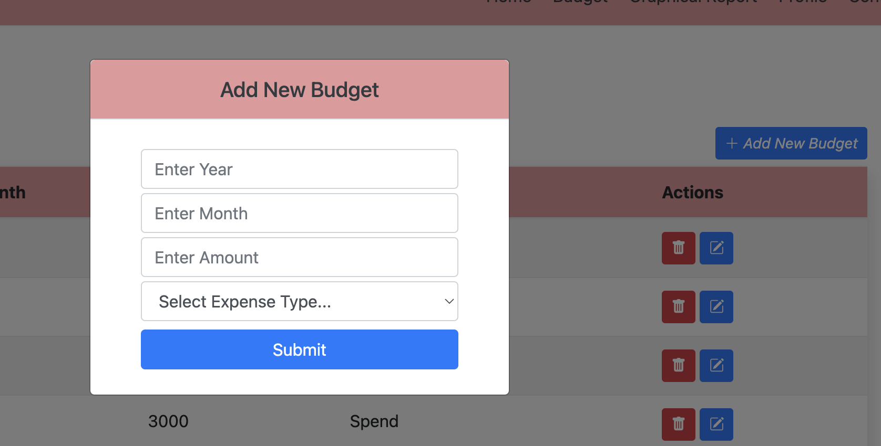
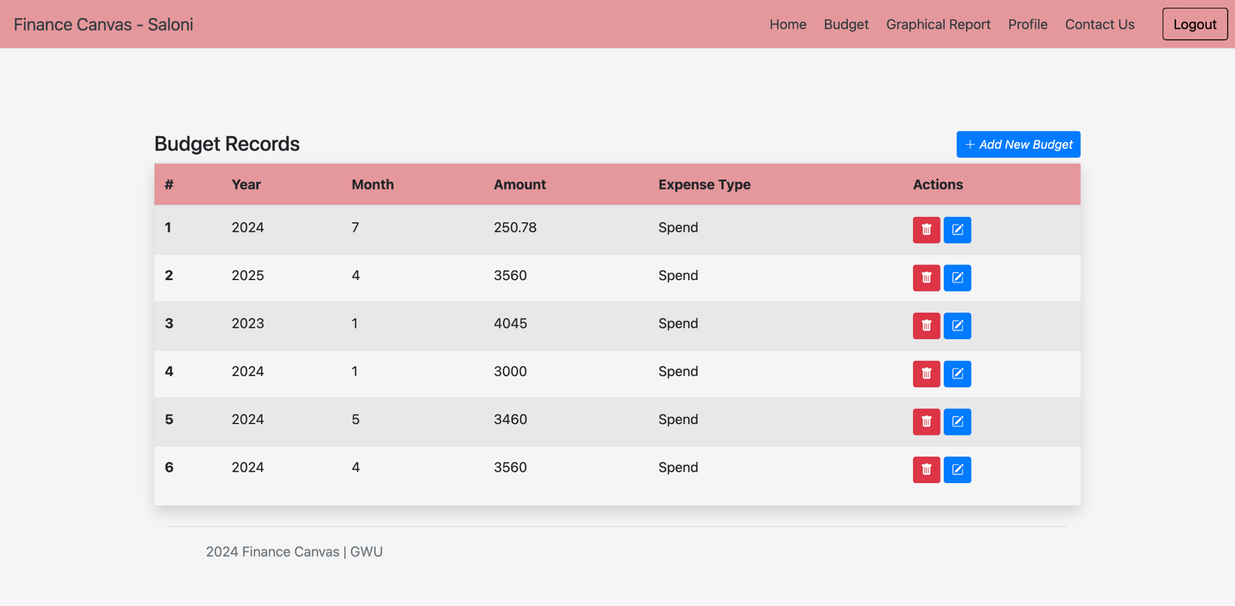
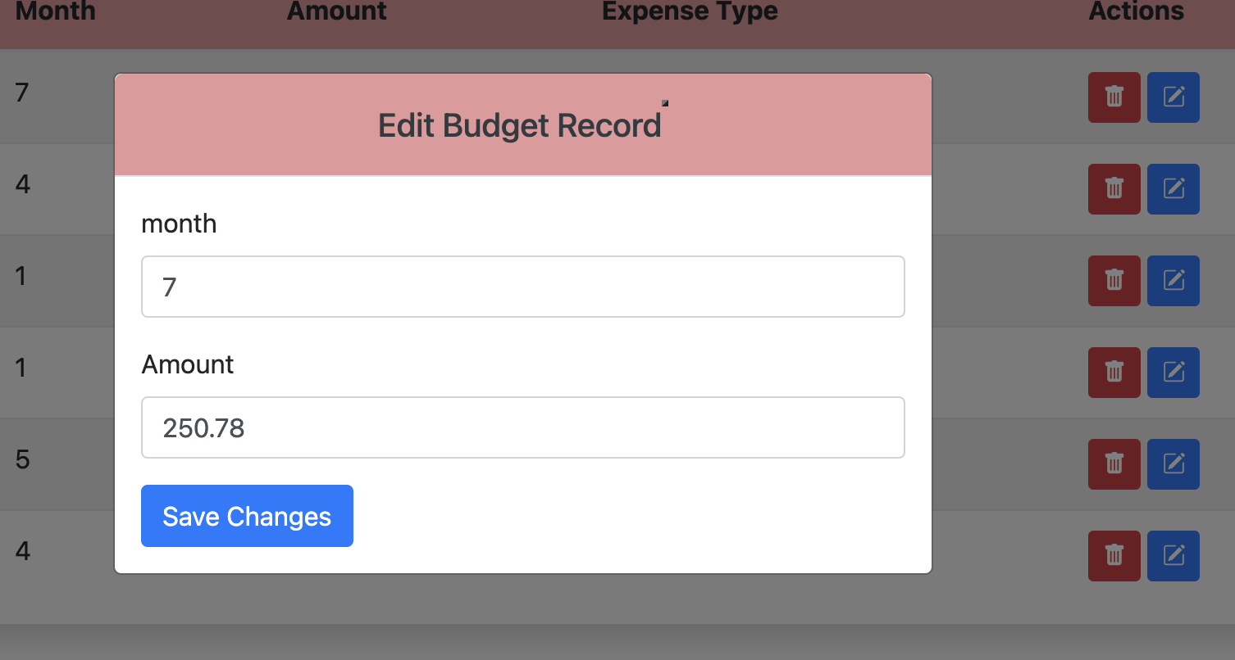
Project Demo - Budget page

Slide 14
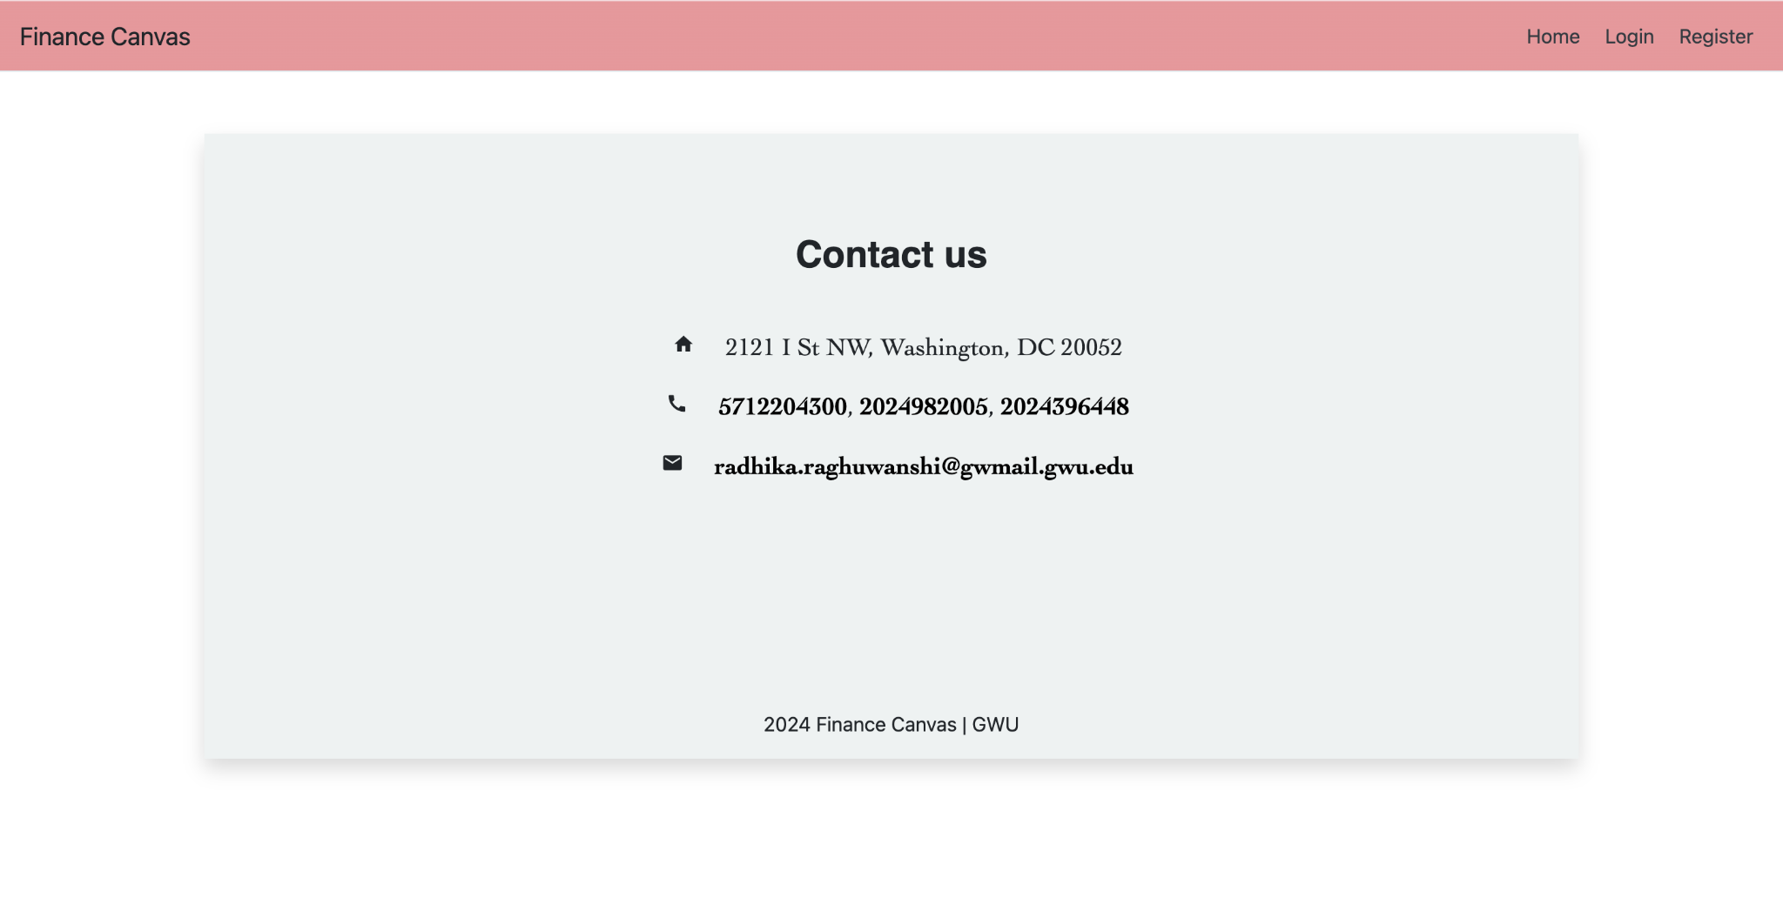
Project Demo: Contact Page

Slide 15
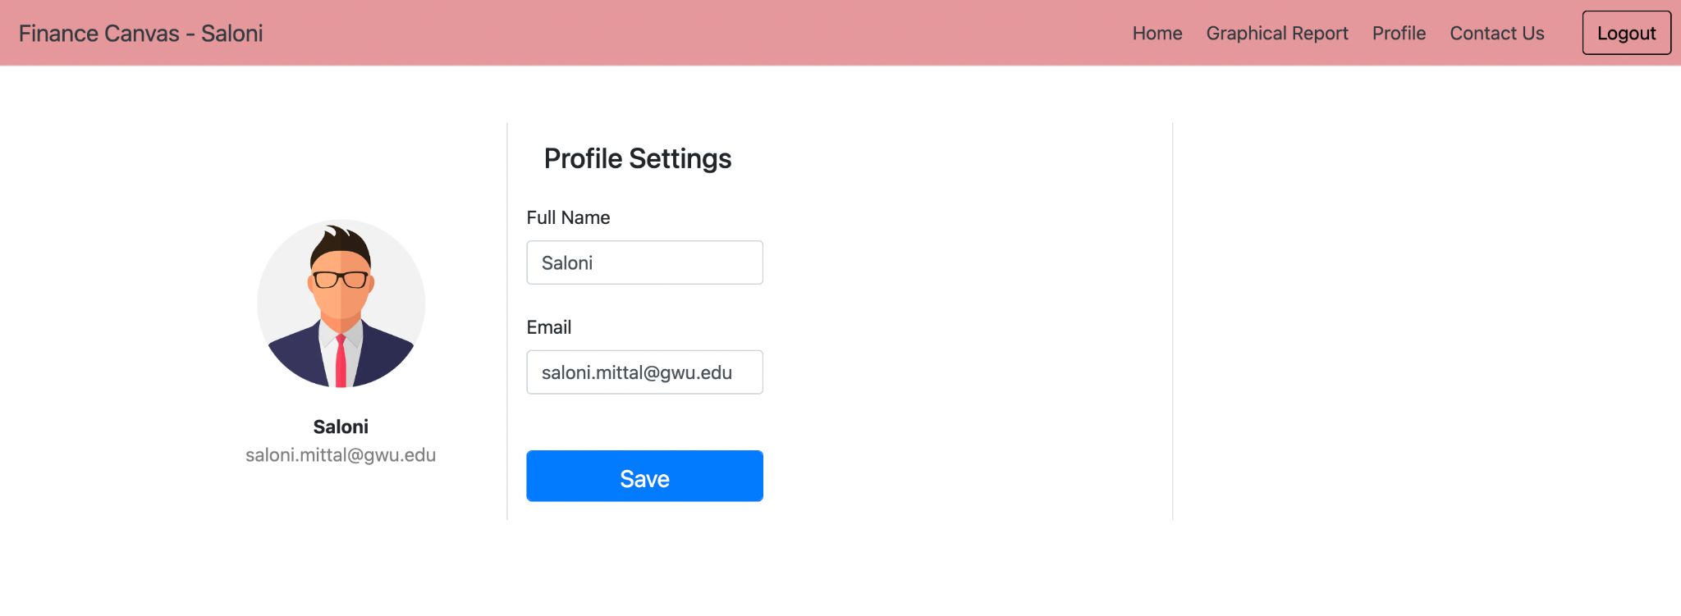
Project Demo: Profile page

Slide 16
Future enhancements:
Advance User Profiles
Expense Reminders and Notifications
Multiple Currency Support
Notes:
Advance User Profiles: Enhance user profiles to include more personalization options, such as setting currency preferences, recurring expense settings, or financial targets.
Expense Reminders and Notifications: Implement reminder features to notify users about upcoming bills, due dates, or irregular spending patterns based on historical data.
Multiple Currency Support: Add support for multiple currencies to accommodate users with diverse financial backgrounds or international transactions, enabling accurate tracking and reporting of expenses in different currencies.

Slide 17
Thank You!

